Slide 1
Naïve Bayes classifier
Sadia Islam
Assistant Professor
Department of Computer Science and engineering
United International University

Slide 2
Naïve Bayes Classifier
Naïve Bayes algorithm is a supervised learning algorithm, which is based on Bayes theorem and used for solving classification problems.
It is mainly used in text classification that includes a high-dimensional training dataset.
It is a probabilistic classifier, which means it predicts on the basis of the probability of an object.
Some popular examples of Naïve Bayes Algorithm are spam filtration, Sentimental analysis, and classifying articles.

Slide 3
Why is it called Naïve Bayes?
Naïve: It’s called naïve because it assumes features are independent—one feature doesn’t affect the others .Such as if the fruit is identified on the bases of color, shape, and taste, then red, spherical, and sweet fruit is recognized as an apple. Hence each feature individually contributes to identify that it is an apple without depending on each other.
Bayes: It is called Bayes because it depends on the principle of Bayes' Theorem.

Slide 4
Bayesian Classifiers
We have multiple attributes (A₁, A₂, ….., A_{n})
  Purpose is to predict the label class C
  C may have multiple values, we want to find the value of C that maximizes P(C|A1, A2, ….., An)

Slide 5
Bayesian Classifiers
Solutions
  Compute the probability of P(C|A₁, A₂, ….., A_{n}) for all the class values using Bayes theorem.
Bayes theorem
P(C|A₁, A₂, ….., A_{n}) = P(A₁, A₂, ….., A_{n}|C) * P(C) / P(A₁, A₂, ….., A_{n})
Where,
P(C|A₁, A₂, ….., A_{n}) = Posterior Probability
P(C) = Priori Probability
P(A₁, A₂, ….., A_{n}) = Probability Density Function
P(A₁, A₂, ….., A_{n}|C) = Class Conditional Probability / Likelihood function of C with respect to A1 A2…
  We need to find the value of C that maximizes P(A₁,A₂,,,,,A_{n}|C) * P(C) as the rest part is constant for all the classes.

Slide 6
Naive Bayes Theorem
Assuming all the features(attributes) are independent of each other given class label
Therefore,
P(A₁,A₂,,,,,A_{n}|C) = P(A₁|C) * P(A₂|C) * ……… * P(A_{n}|C)
We have to find P(A_{i}|C_{j}) for all A_{i} and C_{j} from the training dataset

Slide 7
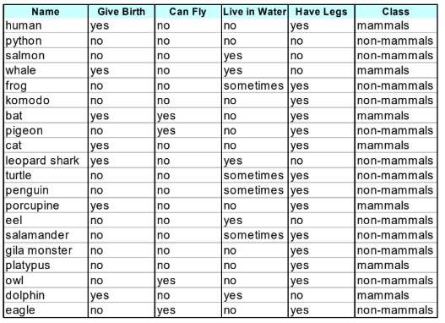

Naive Bayes Theorem - example
Here, Give Birth(GB), Can Fly(CF), Live in Water(LIW), Have Legs(HL) are the features and Class is the output class(label)
Suppose, we are tasked to find
We have to calculate the two probabilities
  P(Class = mammals|GB=yes, CF=no,LIW=yes,HL=no)
  P(Class = non-mammals|GB=yes, CF=no,LIW=yes,HL=no)

Slide 8
Naive Bayes Theorem - example
P(Class = mammals|GB=yes, CF=no,LIW=yes,HL=no) =
P(GB=yes, CF=no,LIW=yes,HL=no|Class = mammals) * P(Class = mammals)
Now, P(GB=yes, CF=no,LIW=yes,HL=no|Class = mammals) = P(GB=yes|Class=mammals) * P(CF=no|Class=mammals) * P(LIW=yes|Class=mammals) * P(HL=no|Class=mammals)
P(GB=yes|Class=mammals) = 6 / 7
P(CF=no|Class=mammals) = 6 / 7
P(LIW=yes|Class=mammals) = 2 / 7
P(HL=no|Class=mammals) = 2 / 7
P(Class = mammals) = 7 / 20

Slide 9
Naive Bayes Theorem - example
P(Class = non-mammals|GB=yes, CF=no,LIW=yes,HL=no) =
P(GB=yes, CF=no,LIW=yes,HL=no|Class = non-mammals) * P(Class = non-mammals)
Now, P(GB=yes, CF=no,LIW=yes,HL=no|Class = non-mammals) = P(GB=yes|Class=non-mammals) * P(CF=no|Class=non-mammals) * P(LIW=yes|Class=non-mammals) * P(HL=no|Class=non-mammals)
P(GB=yes|Class = non-mammals) = 1 / 13
P(CF=no|Class = non-mammals) = 10 / 13
P(LIW=yes|Class = non-mammals) = 3 / 13
P(HL=no|Class = non-mammals) = 4 / 13
And P(Class = non-mammals) = 13 / 20

Slide 10
Naive Bayes Theorem - example
Now, P(GB=yes, CF=no,LIW=yes,HL=no|Class = mammals)
= 6/7 * 6/7 * 2/7 * 2/7 * 7/20 = 0.021
Now, P(GB=yes, CF=no,LIW=yes,HL=no|Class = non-mammals)
= 1/13 * 10/13 * 3/13 * 4/13 * 13/20 = 0.0027
Clearly, the data belongs to the mammal class

Slide 11
Variance calculation
Variance measures how spread out a set of numbers is. Here's a step-by-step example to calculate the variance of a sample:
Find the Mean: Add up all the numbers and divide by the number of numbers.
Subtract the Mean and Square the Result: Do this for each number.
Find the Average of Those Squared Differences: Add up the squared differences and divide by the number of numbers minus one.

Slide 12
Variance calculation - example
.Suppose we have the sample data: 4, 8, 6, 5, 3.
Calculate the Mean: Mean=(4+8+6+5+3)/5 = 26/5 = 5.2
Subtract the Mean and Square the Differences:
(4−5.2)^2=(−1.2)^2=1.44
(8−5.2)^2=2.8^2=7.84
(6−5.2)^2=0.8^2=0.64
(5−5.2)^2=(−0.2)^2=0.04
(3−5.2)^2=(−2.2)^2=4.84
Find the Average of Those Squared Differences:
Variance=(1.44+7.84+0.64+0.04+4.84)/4=14.8/4=3.7

Slide 13
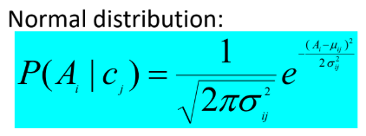
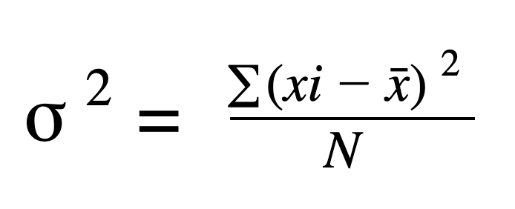
Naive Bayes Theorem - continuous values
We have seen examples for categorical values in previous slides.
For continuous values, we calculate probabilities using normal distribution
𝛔^2 = variance
μ = mean

Slide 14
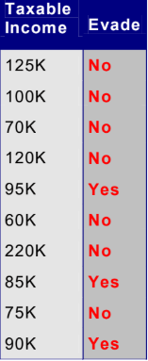

Naive Bayes Theorem - continuous values
To calculate P(TI = 120k | Evade = No)
If class = No,
  Mean = 110k
  Variance = 2975

Slide 15
Example
https://medium.com/analytics-vidhya/use-naive-bayes-algorithm-for-categorical-and-numerical-data-classification-935d90ab273f

Slide 16
Thank You

